Slide 1

YouAnalytics
K.M.A.R.T. consulting
KRISSY STICHNOTE, MORGAN COPELAND, AUSTIN MCCOWAN, RAYMOND CHITAURO, TYRONE BERRY

Slide 2
K.M.A.R.T. Consulting Team Members
Krissy Stichnote, Project Manager
Krissy Stichnote, Project Manager
Morgan Copeland, Developer
Austin McCowan, Developer
Raymond Chitauro, Developer
Tyrone Berry, Developer

Slide 3
Project introduction
Morgan Copeland, Developer
As a YouTuber, a web-based application that will allow you to quickly retrieve analytic information on your YouTube channel as well as videos to help increase viewers and subscribers across the globe. By having this information, you can optimize your channel and gain more traffic. The project itself will be accessed through a webpage where users can utilize features and gain benefits through the analytic information gained. Further this document will yield additional and more in-depth information revolving around the project, such as client operations or cost summary.
Let me introduce to you, YOUANALYTICS.

Slide 4

Project proposal Client Operations Morgan Copeland, Developer
Client will be able to enter their YouTube credentials and information requested into a web page and quickly retrieve analytic information from a Google provided application program interface for their channel and all videos. The information would include statistics such as the client’s view total, number of likes, minutes watched, view duration, and number of subscribers.

Slide 5

Project Proposal Executive Summary Tyrone Berry, developer
Many YouTube content creators are left wondering about the impact that their content leaves on viewers. How many people watch their videos? For how long do those viewers stay engaged with the content? What about direct personal feedback in the form of likes, dislikes, or comments? YouAnalytics will provide a way to access that information through a convenient and simple user interface. Using the power of YouTube Analytics API, users will be provided all the data they need to gain insight into their content. This application will be a handy tool for anyone who seeks to demystify the environment of online content creation.

Slide 6
Project proposal Cost summary & terms and conditions Tyrone Berry, developer
Cost Summary
The following costs are estimated, non-recurring costs, to complete the project. With the development tools and API’s being available at no cost, the only cost incurred will be the cost of time for our team.
This project will require four developers and a project manager to complete the project in 6 weeks (about 1 and a half months). Due to the short amount of time it takes to get this project completed we are dedicating a total of 50 hours per week to complete the project. Total cost for the project will be $11,500. See Terms and Conditions for payment schedule.
Terms and Conditions
Price and payment: Client will pay 50% ($5,750) of the project fee to start the project. 25% ($2,875) will be due following review of the product before it is finalized. Once the project is complete, the remaining amount of $2,875 will be due to receive the final application.
Cancellations: If the client fails to pay or decides to cancel the project, a refund will be pro-rated and returned to the client for any payments made. If K.M.A.R.T. Consulting fails to deliver the finished product, the client will receive a full refund.
Intellectual property: K.M.A.R.T. Consulting owns the product fully until the product is finalized and delivered to the client.
Sharing work: Once the product is finalized and delivered to the client, the client can share the product as they wish.
Changes: Change requests will be submitted to the project manager as soon as possible to approve appropriate changes with the development team. A change request meeting will be held weekly, if needed, to review and approve/decline any changes.

Slide 7
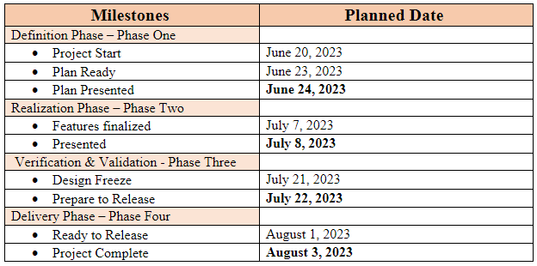
Statement Of work Austin Mccowan, developer
Scope
Using K.M.A.R.T. Consulting we will provide a web-based application used to quickly retrieve the following analytic information:
Views
Likes
Estimated minutes watched
Average view duration
Channel Subscribers
This application will take a user’s YouTube credentials and use the YouTube Analytics API from Google to request the data.
If the user’s information is incorrect then an error message will display.
Out of Scope
Login system including creation of user account
Period of Performance
Work will be completed within 6 weeks.
Place of Performance
Developers are conducting development and testing on their local environment using Visual Studio Code as the integrated development environment. Version control and source code storage will be on GitHub. Work will be performed at individual developer’s homes or office locations and not at client sites.
Schedule/Milestones

Slide 8



Work requirements (sow) Austin Mccowan, developer
Team Requirements
4 developers
1 project manager
Development Tools
GitHub
Visual Studio Code
Django, Python
Html, CSS
API's
Google YouTube Analytics

Slide 9

Acceptance Criteria (SOW) KRISSY STICHNOTE, PROJECT MANAGER
For the Front-end
Code review has been performed
Client end-to-end test performed
Client signoff on layout and user interface
For the Back-end
Accepted pull request:
Including code review, end-to-end test, successful return of required API data and successful review of error handling.

Slide 10

Future work KRISSY STICHNOTE, PROJECT MANAGER
A Login system that remembers a user's YouTube name and password
A date filter
Geographic filer (Country and state/province specific)
Playback location
Device or OS Specific
Social Media (Twitter, Facebook, etc)
Traffic Source

Slide 11

Thank You
K.M.A.R.T. Consulting
Krissy stichnote
Morgan copeland
Austin mccowan
Raymond chitauro
Tyrone berry

